Slide 1
Britain is a land of ancient cities, royal palace, massive cathedrals, and legendary sites. Mighty castles, stately homes, glorious gardens, and tiny picturesque villages enhance the natural beauty of the countryside.

Slide 2
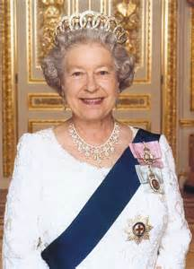
Welcome to U.K
Queen Elizabeth II 1952 - present day Elder daughter of George VI. Her coronation, on June 2, 1953, made Queen Elizabeth II is the 40th monarch .

Slide 3
Royal Family tree

Slide 4
The history of U.K
In 1536, under Henry VIII, an Act of Union was passed making Wales, in effect a province of England. The "United Kingdom of Great Britain and Northern Ireland," usually shorten to the U.K came into being on 1 May 1707.
Union Jack, is called the national flag of the United Kingdom. It is made up of the individual Flags of three of the Kingdom's countries.
St. George's Cross, the flag of England
St. Andrew's Cross, the flag of Scotland
St. Patrick's Cross, the flag of Ireland

Slide 5
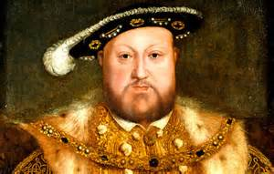
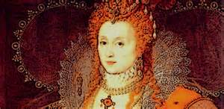
The greatest monarchs in the British history
King Henry VIII 1509 - 1547 Second son of Henry VII. Henry succeeded to the throne because his elder brother Arthur died in 1502. His first wife, Catherine of Aragon, was Arthur's wife. The best known fact about Henry VIII is that he had six wives! Argued with the Pope and made himself the head of the new 'Church of England'.
Queen Elizabeth I 1558 - 1603 Daughter of Henry VIII and Anne Boleyn. During her reign great adventurers discovered many new lands. Named James VI of Scotland her heir, uniting the two countries Scotland and England. Elizabeth I was the last ever Queen of England. From now on the monarch, although living in England, would be known as the Monarch of the United Kingdom.

Slide 6
Queen Victoria 1837 - 1901
She was the daughter of Edward, duke of Kent (fourth son of George III) and a niece of George IV and William lV.
She ruled during the industrial revolution. The British Empire became powerful, rich and confident. When Victoria died in 1901, after the longest reign in English history, the British Empire and British world power had reached their highest point. She had 9 children, 40 grand-children and 37 great-grandchildren, scattered all over Europe.

Slide 7
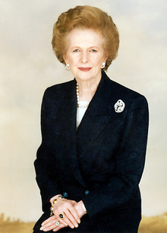
All the great things are simple, and many can be expressed in a single word: freedom, justice, honor, duty, mercy, hope. Winston Churchill
Sir Winston Churchill was a British prime minister and statesman who led the country to victory against Nazi Germany and the Axis powers in World War Two.
Margaret Hilda Thatcher, Baroness Thatcher(13 October 1925 – 8 April 2013), was the Prime Minister of the U.K from 1979 to 1990 .She was the longest-serving British Prime Minister of the 20th century and is the only woman to have held the office. A Soviet journalist called her the "Iron Lady", a nickname that became associated with her uncompromising politics and leadership style.

Slide 8
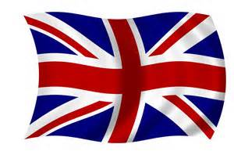
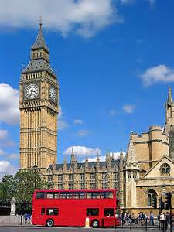
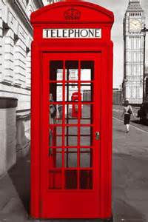
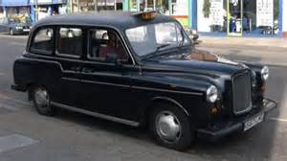
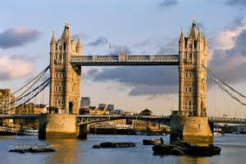
London the capital of Great Britain

Slide 9
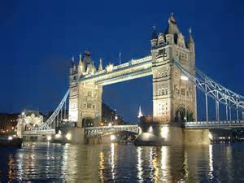
Some things that you can’t miss while you are in London
Harrods- the place where you can bye anything

Slide 10
Giant’s Causeway The Giant's Causeway is an area of about 40,000 interlocking basalt columns, the result of an ancient volcanic eruption. It is located on the northeast coast of Northern Ireland.
Stonehenge is a prehistoric monument located in Wiltshire ,England.

Slide 11
Big Ben and London Eye
It is the world’s biggest ferries wheel, and will carry 800 passengers at a time on a thirty-minute ride.

Slide 12
Royal Guards
The Queen's Guard and Queen's Life Guard are the names given to soldiers charged with guarding the official royal residences in the UK. They are responsible for guarding Buckingham Palace in London

Slide 13
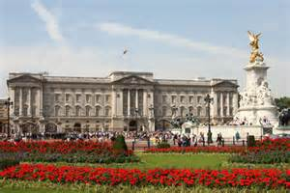
Buckingham Palace is the home of the British Royal family. The 600 room palace is surrounded by a 40 acre garden.
Double- Decker buses the symbol of the public transport in England

Slide 14
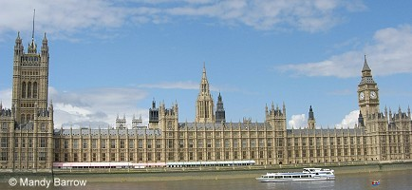
The Palace of Westminster
The Palace of Westminster, known also as the Houses of Parliament, is where the two Houses of the Parliament of the United Kingdom (the House of Lords and the House of Commons) conduct their sittings. The Palace lies on the north bank of the River Thames in the London borough of the City of Westminster.

Slide 15
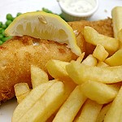
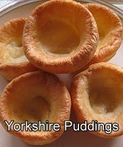
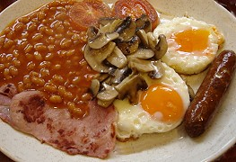
Fish and Chips
Traditional English breakfast

Slide 16
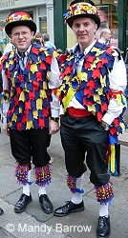
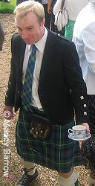
There are wide varieties of costumes from the spectacular ceremonies associated with monarchy to the traditional costumes worn by Morris dancers and others at English country fairs
In Scotland the national dress is a kilt. The history of the kilt stretches back to at least the end of the 16th century.
The kilt is worn around the waist. Nowadays, the kilt is seen as the national dress of Scotland

Slide 17
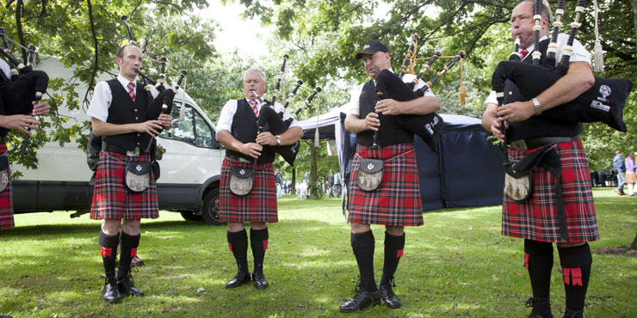
Bagpipe Scotland's national instrument made from the skin of a sheep. The melody is played on a receded chanter leading down from the bag while the three drone pipes sit on the piper's shoulder and provide a constant, steady sound as a background to the melody. Tartan, is Scotland’s most famous textile, the first known mention of tartan in Scotland dates from 1538. This patterned woven cloth has become one of the most iconic symbols of Scottish culture.

Slide 18
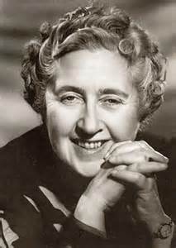
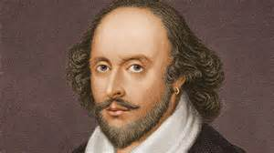
William Shakespeare William Shakespeare, often called the English national poet, is widely considered the greatest dramatist of all time. The author of many tragedies such as: “ Romeo and Juliet’’
Agatha Christie
Christie can also be considered a queen of all publishing genres as she is one of the top-selling authors in history, with her combined works selling more than 2 billion copies worldwide.

Slide 19
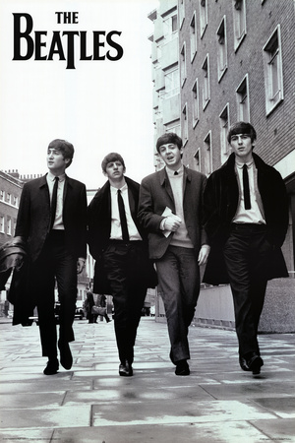
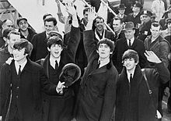
They hold the record for most number-one hits on the Hot 100 chart with twenty. They have received ten Grammy Awards , an Academy Award and are considered the twentieth century's 100 most influential people, they are the best-selling band in history, with estimated sales of over 600 million records worldwide

Slide 20
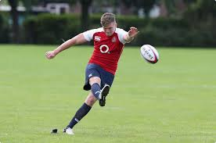
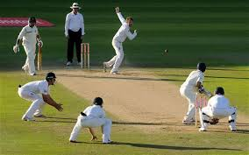
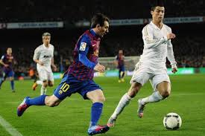
Rugby football is one of many versions of football played at English public schools during the 19th century
Cricket is a bat-and-ball game played between two teams of 11 players each on a field Cricket was first played in southern England in the 16th century. By the end of the 18th century, it had developed to be the national sport of England
Soccer
The Laws of the Game were originally codified in England by The Football Association in 1863.

